Slide 1
Assessment Type 1 Task 3 Machine Learning using SageMaker - (Individual)
SACE ID - 671489F

Slide 2
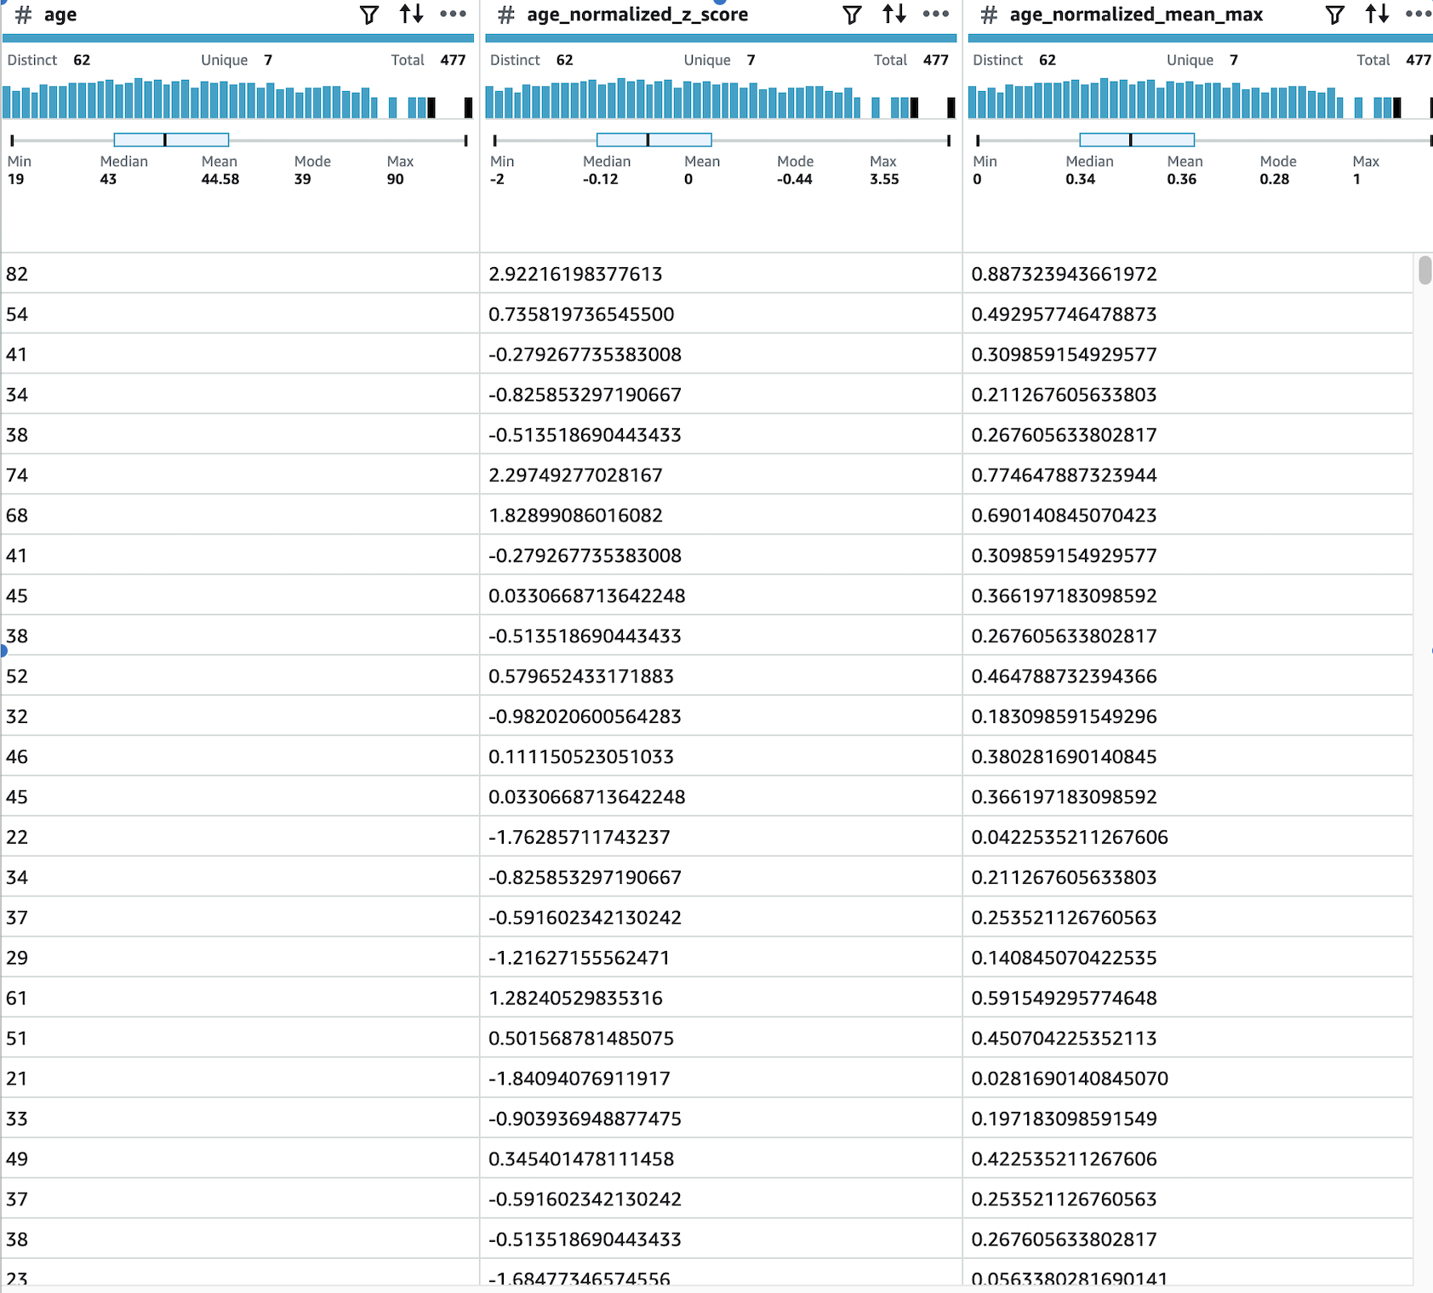
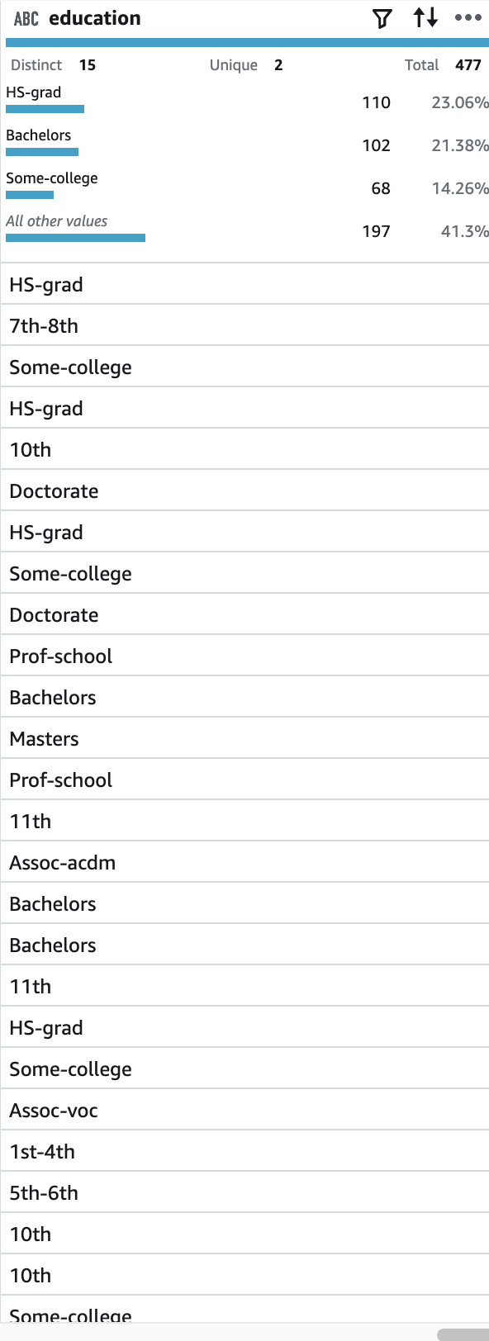
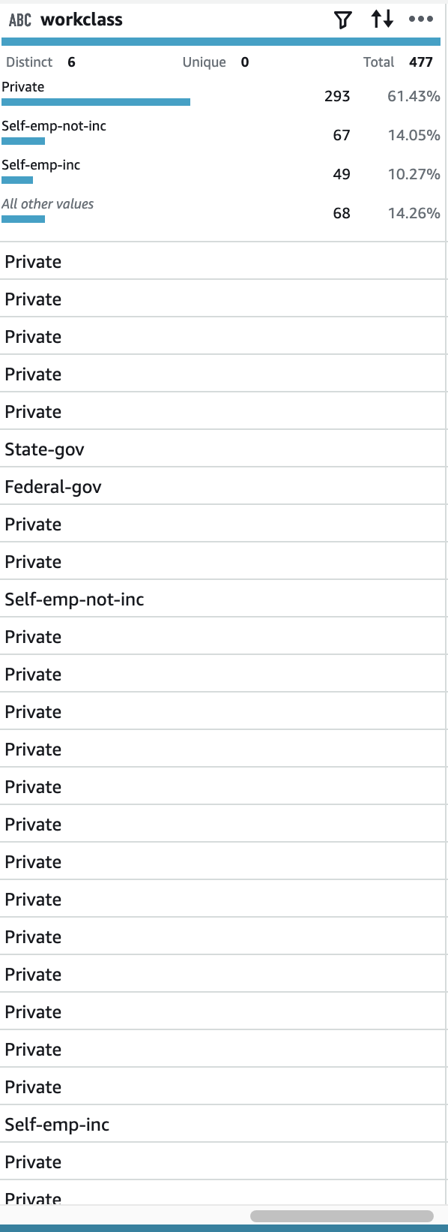
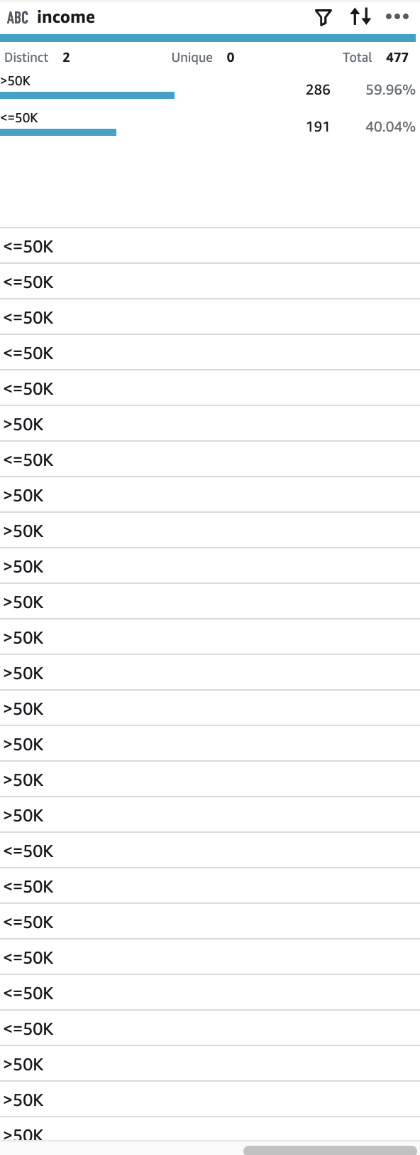
Conclusion
The entirety of what we were required to complete was completed and modified to source relevant information and data to me in preparation for task 3.
This is the final product that the program led to for me, a list compiled to retain and modify (public accessible) data regarding peoples age, education level and occupation level in the work force in relation to finance.

